Slide 1
Children Monitoring System
Team Members:
Avinash Vasadi
Neeraja Garigipati
Kavya Sri Margam
Harnath Vagicharla
Vaishnavi Kalvakota
Akhila Reddy Pattlola
Lavanya Kalluri

Slide 2

Client
The client to whom we are doing this project is Dr. Zhengrui Qin.

Slide 3







Team Members

Slide 4
Outline
Introduction
Current Problem
Proposed Solution
Functional Requirements
Use case Diagrams
Tools and Technologies
Status Report

Slide 5
Introduction
This is a software system that keeps track of the children of the registered user and provide periodical data about the location.
The system provides
The current location of the child
History of locations

Slide 6
Current Problem
The current problem the parents facing is that, they don’t have any information about the locations their children who are travelling.
Because of some safety and security issues the parent want to monitor their children travel location and keep track of them.
So to solve this current problem we are designing a solution that would better serve the purpose and solve it.

Slide 7
Proposed Solution
We are developing a system that provides the location of children of the registered user.
The parent who wants to keep track of the location of their children has to register and enter the required details for the system to produce the data.
Then the system will periodically gets the location of the child and add it to the database.
Finally the parent can view the current location and history of the locations the child travelled.

Slide 8
Functional Requirements
Functional requirements define the function and behavior of the system. They also the components of the system.
The system consists of the following modules
Login/ Signup
Add child/ Delete Child
Records Management
Track Location
Settings Page
Alerts Page

Slide 9
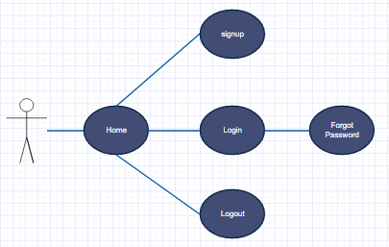
Use Case Diagrams

Slide 10
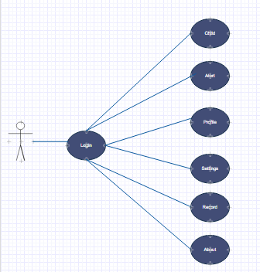
Use Case Diagrams

Slide 11
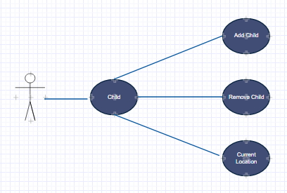
Use Case Diagrams

Slide 12
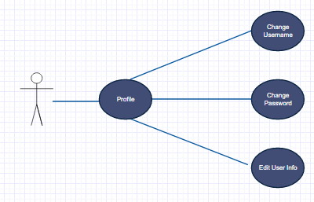
Use Case Diagrams

Slide 13
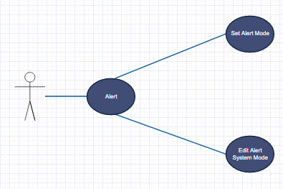
Use Case Diagrams

Slide 14
Tool and Technologies
Tools
Visual Studio Code
Git Bash
Postman
Tortoise Git

Slide 15
Tool and Technologies
Technologies
Java Script
HTML, CSS, Bootstrap
Node.js
Database
Backendless

Slide 16
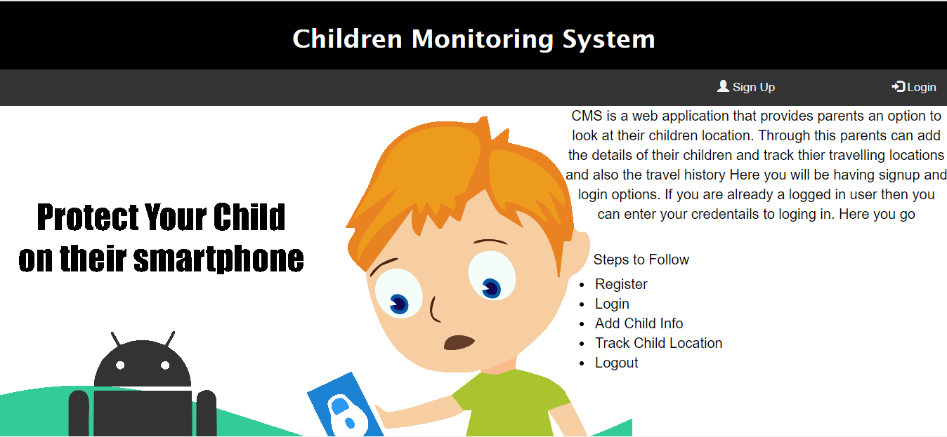
Home Page

Slide 17

Login Page

Slide 18
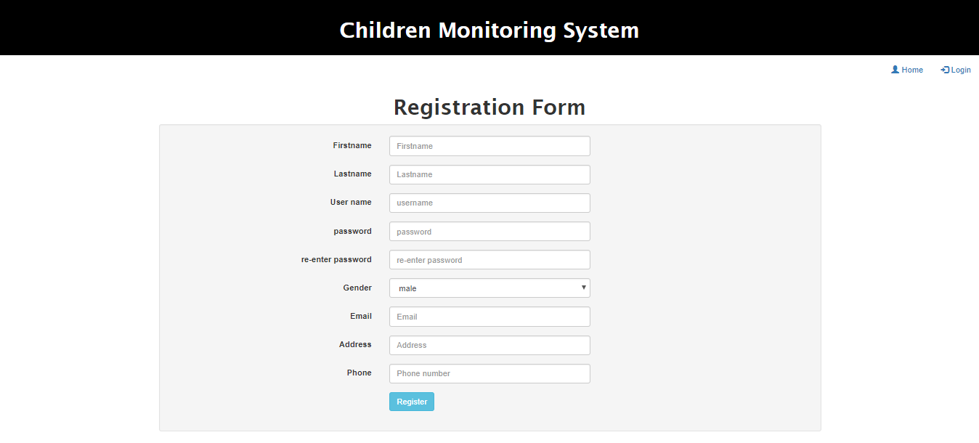
Sign Up

Slide 19
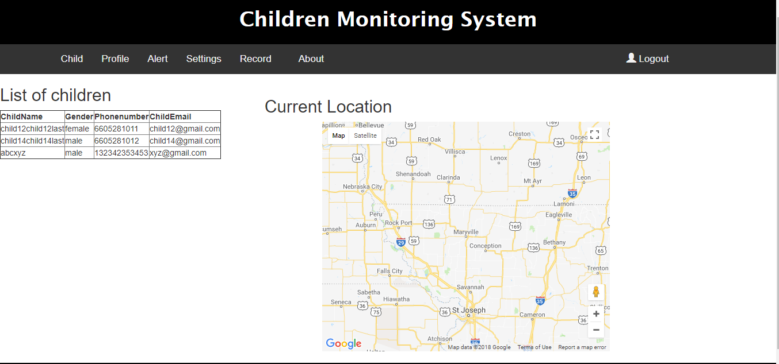
Location Page:

Slide 20
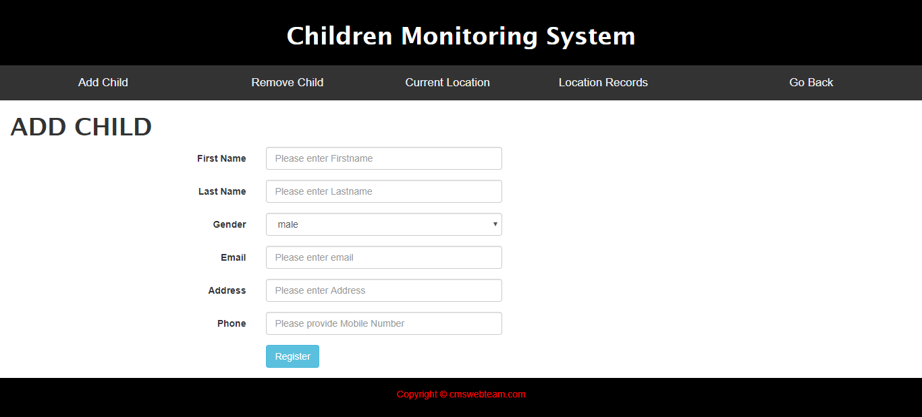
Add Child

Slide 21
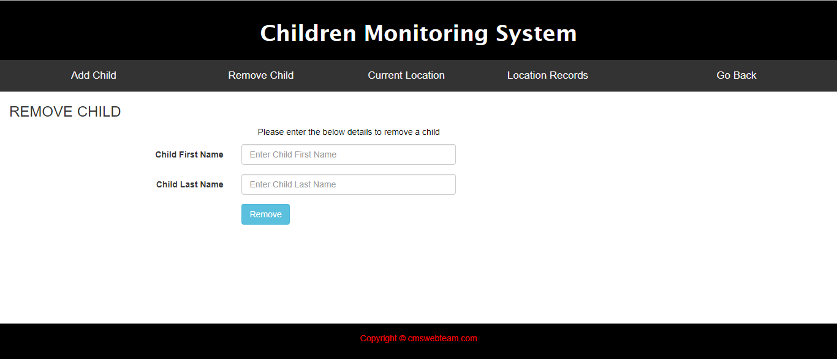
Remove Child

Slide 22
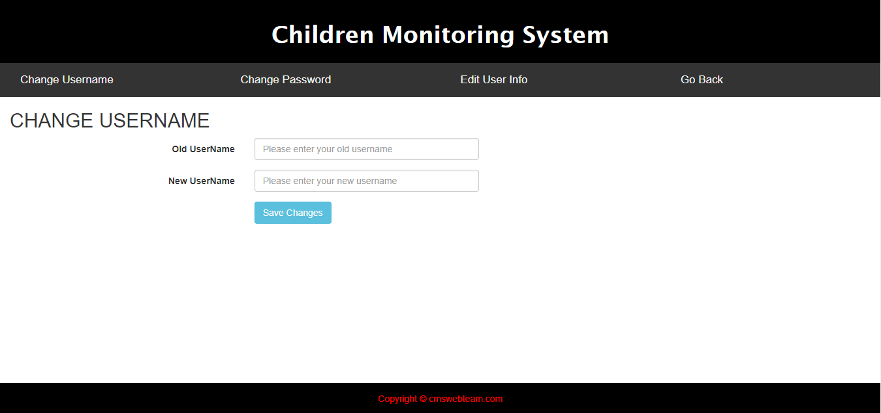
Profile Page

Slide 23
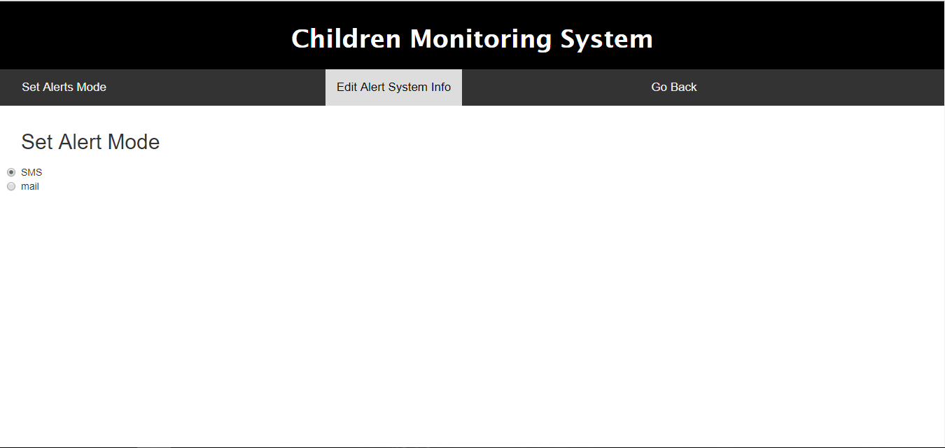
Alert Page

Slide 24
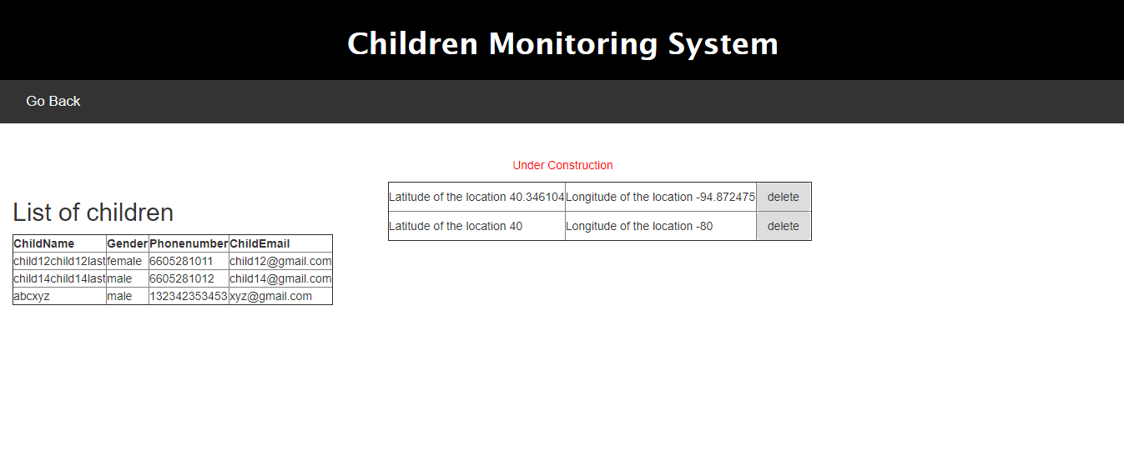
Records Management Page

Slide 25
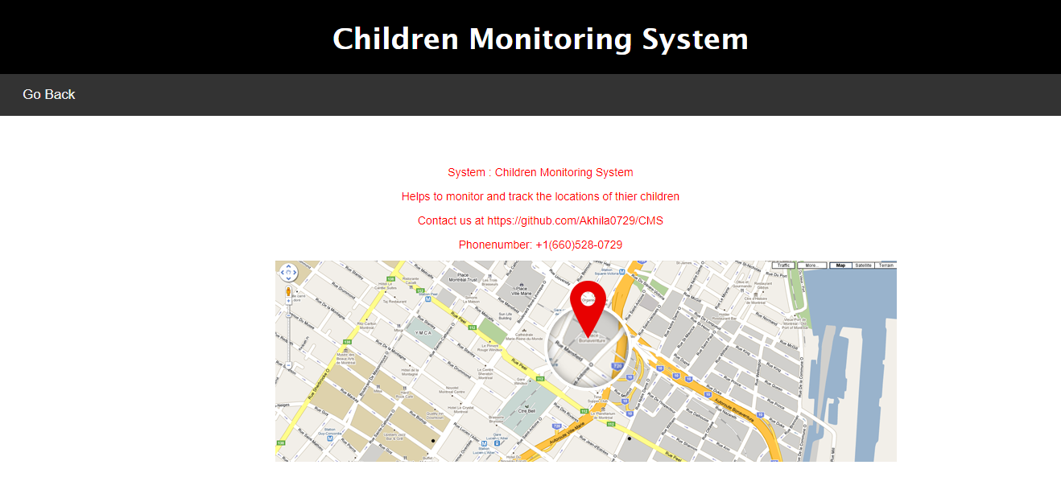
About Page

Slide 26
Status Report
Tasks Completed
Login Management
Home Page
Children Management
Profiling
Add child
Delete child

Slide 27
Status Report
Tasks Completed
Displaying the real time location
Alert triggering
Editing user information
Settings of Alerts
Records Management Page

Slide 28
Challenges Faced
Changing the whole database from Back For App to Backendless
Adding of child dynamically into database
Retrieval of location of the child

Slide 29

Demo

Slide 30


